Slide 1


Analysis of Facebook Marketplace Dataset
Vaishnavi S

Slide 2


Contents
Relation b/w num_reactions and time of posting
Correlation b/w engagement metrics and num_reactions
Elbow method for optimal clusters
Training a k-means model
Count of different types of posts
Average value of different features

Slide 3
Q1. Relation b/w num_reactions and time of posting
The number of reactions has an erratic trend throughout the day and depends on the time of posting. It severely drops in the early hours of the day and late hours of the night, considering natural sleep times of a majority of the population.
It sees a steady hike in the morning, with a sudden spike at around 6 a.m., since a lot of people check their phones immediately after they wake up.
Later, there is a drop and the trend is maintained at an almost steady state during the usual work hours. The number again sees a rise in the evening, when most people get off work and spend time on social media, with the highest number being achieved around 7 p.m.

Slide 4
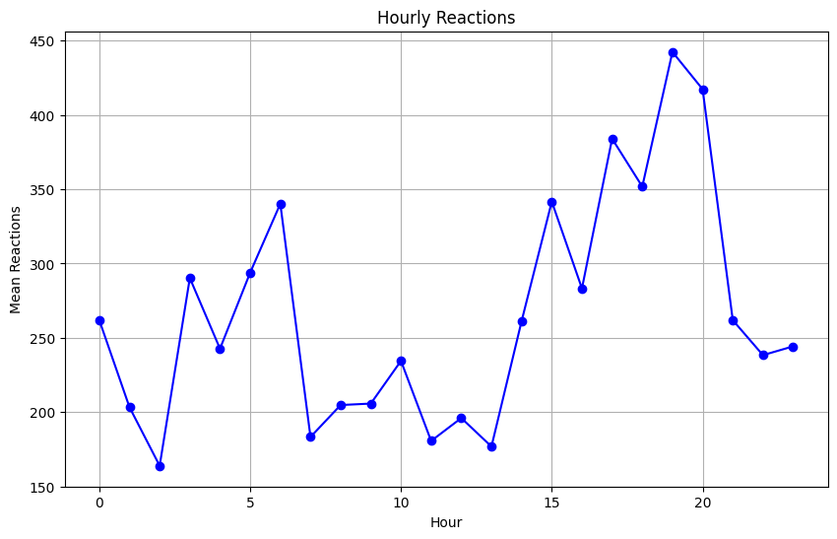
Graph

Slide 5
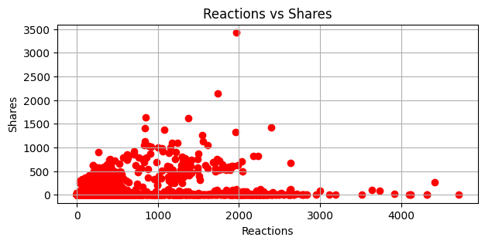
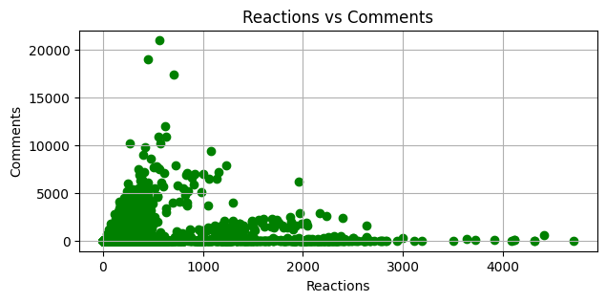
Q2. Correlation b/w engagement metrics and num_reactions

Slide 6
Analysis
Correlation method used – Spearman’s Correlation (due to non-linear relationships)
Correlation between num_reactions and num_shares: 0.557
These features have a positive monotonic relationship, indicating that the increase in one feature generally causes an increase in the other, but it need not be a strictly linear relationship.
Correlation between num_reactions and num_comments: 0.731
Indicates a very strong positive monotonic relationship. Increase or decrease in one feature most likely causes a change in the same direction for the other feature as well.

Slide 7
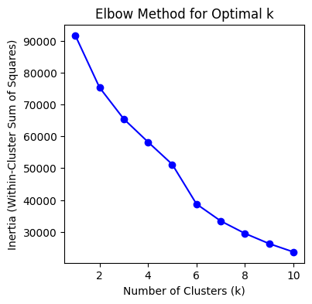
Q3. Elbow Method for Optimal Clusters
Optimal number of clusters = 5

Slide 8
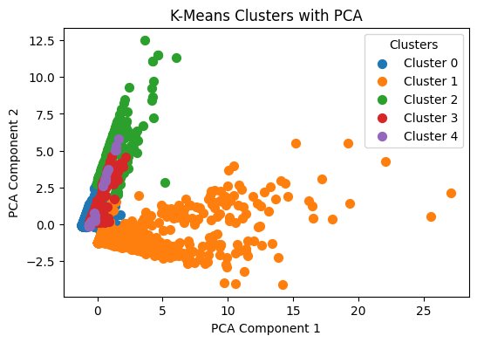
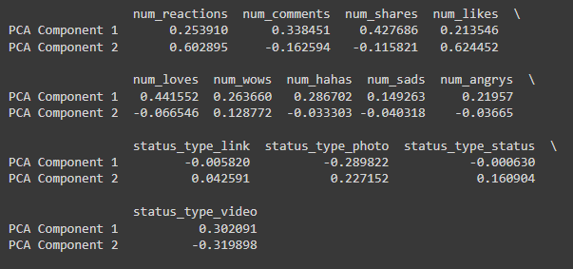
Q4. Training a k-means model

Slide 9
Analysis
The required columns were selected from the original dataframe and were scaled and transformed.
The elbow method clearly suggests that the optimal number of clusters is 5.
PCA was used for dimensionality reduction since a huge number of features were used while training the k-means model. Hence the visualization would be very challenging. PCA helps to curb this problem.
The major contributors for PCA Component 1 are the engagement metrics like shares, comments, likes, and reactions like wows, happys, sads, etc. On the other hand, the contributors for PCA Component 2 are the types of posts, like video, photo, link, and status.
The clusters are highly overlapping and hence might imply a lot of shared characteristics between the them.
Cluster 1 - Has high variability, and indicates varied responses for each post of a similar type
Cluster 0 and 2 - Achieves consistent results with the engagement metrics across different types of posts and hence displays stability
Cluster 3 and 4 - Show diversity in engagement metrics, but are probably meant for a niche audience with a preference for specific content type.
Hence, the creators of the posts must analyze why posts in cluster 1 are getting varied reactions and also draw insights from clusters 0 and 2, since they show consistency with respect to the metrics.

Slide 10
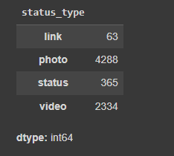
Q5. Count of different types of posts
Most posts are of the type "Photo", closely followed by "Video". While "Status" is posted a considerable number of times, "Links" are barely used. This highlights the content preferences of the audience.

Slide 11
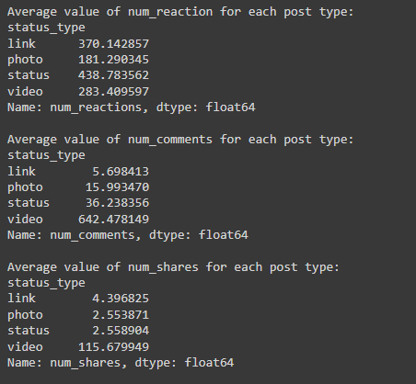
Q6. Average value of different features
Videos are shared the most and also receive the highest number of comments, while links gain the highest number of reactions on an average. The other post types have a consistent number of shares and comments on an average.

Slide 12
Thank You

